Slide 1
EEG Project week 7

Slide 2
Confusion Matrix
for stimulations

Slide 3
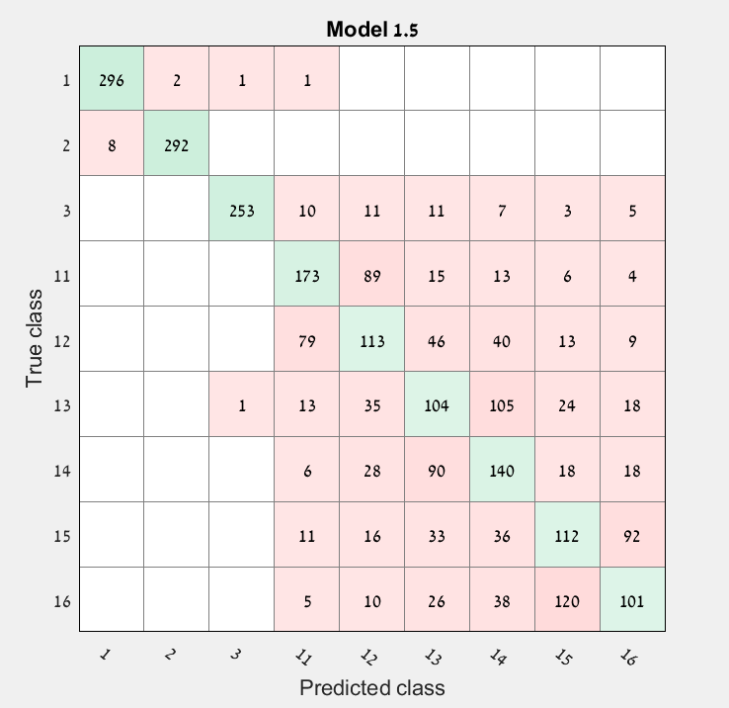
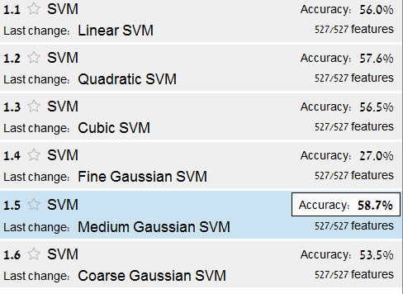
Confusion Matrix based on data from C01, C02, C03 100 trials from each subject for each stimulation

Slide 4
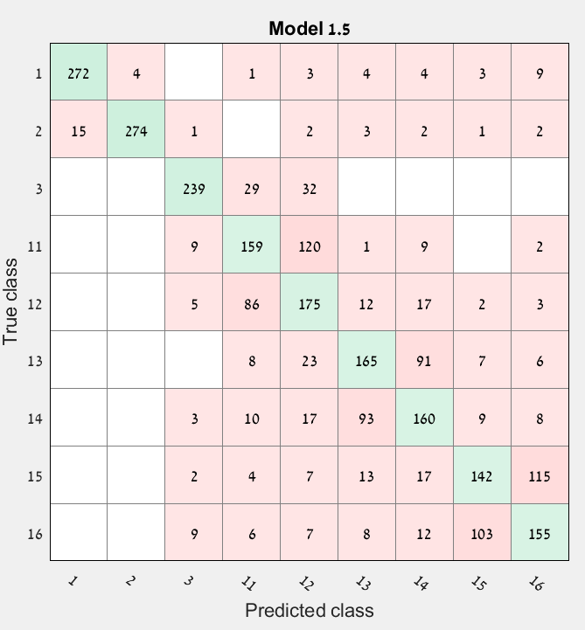
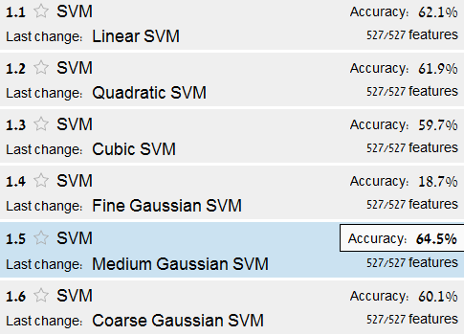
Confusion Matrix based on data from C04, C05, C06 100 trials from each subject for each stimulation

Slide 5
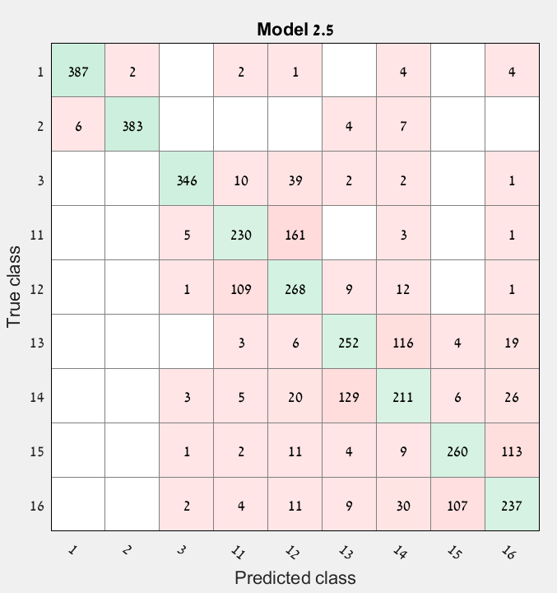
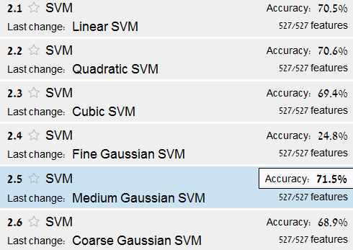
Confusion Matrix based on data from C08, C10, C11, C12 100 trials from each subject for each stimulation

Slide 6
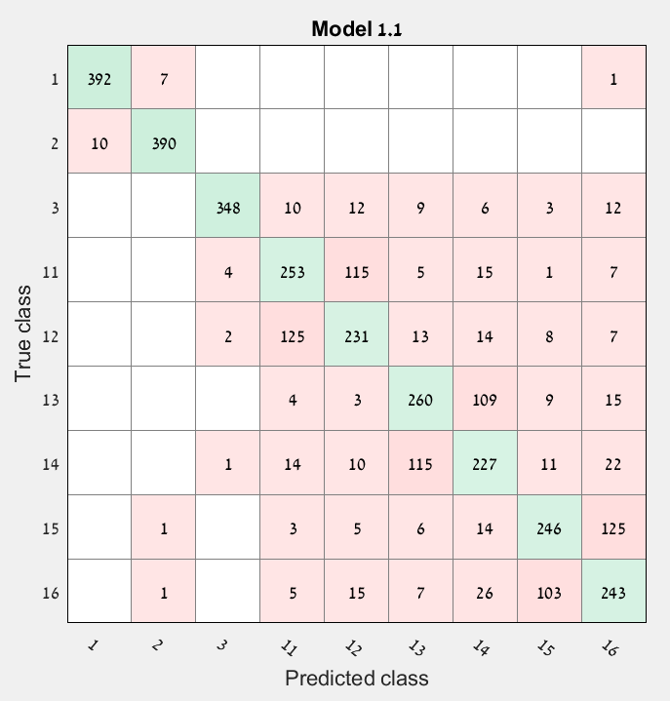
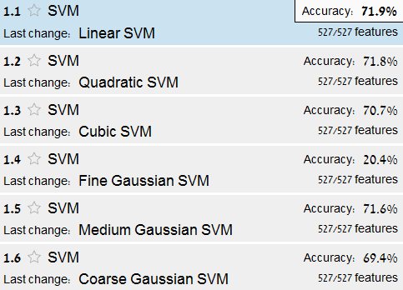
Confusion Matrix based on data from C08, C10, C11, C12 100 trials from each subject for each stimulation after parallel transport

Slide 7
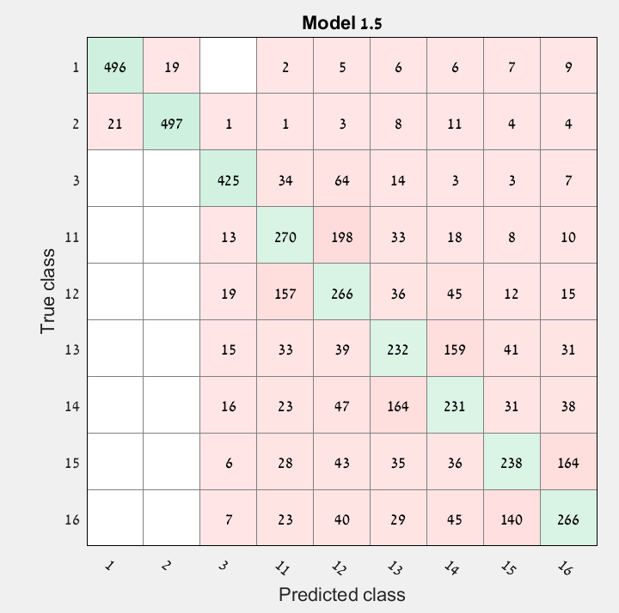
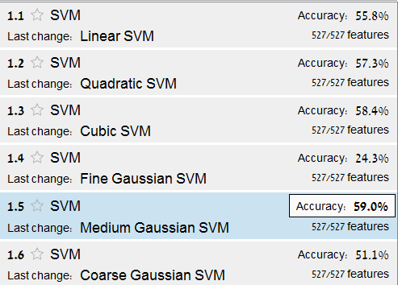
Confusion Matrix based on data from all healthy subjects 50 trials from each subject for each stimulation

Slide 8
Parallel Transport

Slide 9
Subjects C01, C02 Stimulations 01, 03, 12 200 trials for each stimulation
PCA without parallel transport
PCA with parallel transport

Slide 10
Subjects C01, C02 Stimulations 01, 03, 12 200 trials for each stimulation
t-SNE without parallel transport
t-SNE with parallel transport

Slide 11
Subjects C01, C02 Stimulations 01, 03, 12 200 trials for each stimulation
t-SNE without parallel transport
After diffusion maps
t-SNE with parallel transport
After diffusion maps

Slide 12
Subjects C01, C02 Stimulations 01, 03, 12 200 trials for each stimulation using kernel matrices
PCA without parallel transport
PCA with parallel transport

Slide 13
Subjects C01, C02 Stimulations 01, 03, 12 200 trials for each stimulation using kernel matrices
t-SNE without parallel transport
t-SNE with parallel transport

Slide 14
Subjects C01, C02 Stimulations 01, 03, 12 200 trials for each stimulation using kernel matrices
t-SNE without parallel transport
After diffusion maps
t-SNE with parallel transport
After diffusion maps

